Slide 2
Lesson 1: Object Oriented Fundamentals (10hrs)
Introduction
Object-Oriented Analysis and Design
Iterative development and unified process
Case Study
Understanding Requirements
Use Case modeling, Relating Use cases — include, extend and generalization
Overview of the Unified Modeling Language: UML Fundamentals and Notations

Slide 3
USE CASE
Purpose: Describe use cases that an automated teller machine (ATM) or the automatic banking machine (ABM) provides to the bank customers.
Summary: Customer uses a bank ATM to check balances of his/her bank accounts, deposit funds, withdraw cash and/or transfer funds. ATM Technician provides maintenance and repairs to the ATM.

Slide 4
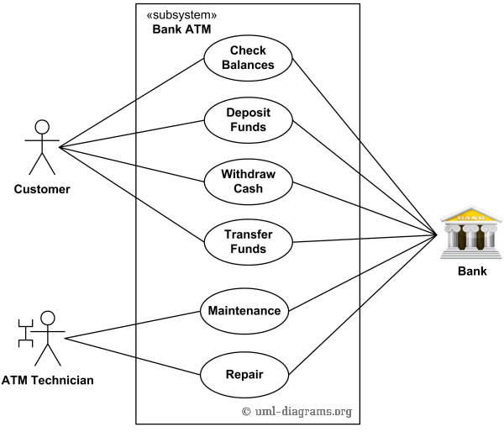
USE CASE
<<BANK>>

Slide 5
USE CASE
Purpose: List top level use cases for e-Library online public access catalog.
Summary: Patrons of a library can search library catalog online to locate various resources - books, periodicals, audio and visual materials, or other items under control of the library. Patrons may reserve or renew item, provide feedback, and manage their account.

Slide 6
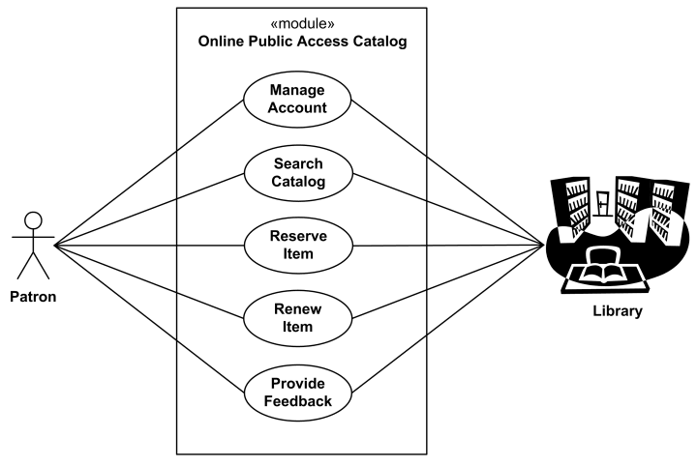
USE CASE
Student

Slide 7
USE CASE
Purpose: Website management or administration UML use case diagrams example.
Summary: Website Administrator actor could manage user groups, users, user sessions, and logs. Help Desk staff uses a subset of functions available to the Website Administrator.

Slide 8
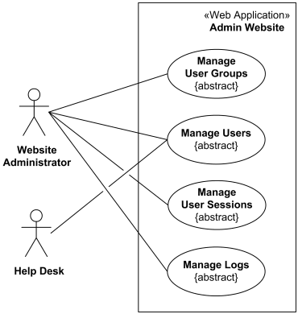
USE CASE

Slide 9
USE CASE
Suppose we want to develop software for an alarm clock.
The clock shows the time of day. Using buttons, the user can set the hours and minutes fields individually and choose between 12 and 24-hour display.
It is possible to set one or two alarms. When an alarm fires, it will sound some noise. The user can turn it off or choose to ’snooze’. If the user does not respond at all, the alarm will turn off itself after 2 minutes. ’Snoozing’ means to turn off the sound, but the alarm will fire again after some minutes of delay. This ’snoozing time’ is pre-adjustable

Slide 10
USE CASE
Identify the top-level functional requirement for the clock, and model it with a use case diagram.
I assume that ’snooze’ would be one of your use cases. Work it out to the fully dressed level.

Slide 11
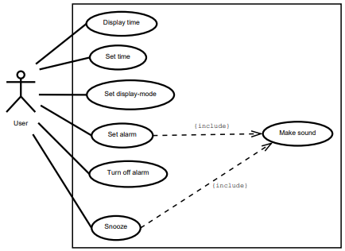
USE CASE

Slide 12
USE CASE
Use case: Snooze.
Primary actor: User
Pre-condition: An alarm is firing.
Post-condition: Alarm fires again after pre-defined timing.
Main flow:
The use-case is activated when the user hits the snooze button.
The alarm is turned off.
Wait for snooze time.
Include the use case ’Make sound’.

Slide 13
USE CASE
Use case: Make sound
Primary actor: System
Pre-condition: An alarm is firing.
Post-condition: Alarm stops firing and becomes silent.
Main flow:
The use case starts when it is called. The system makes some noisy sound.

Slide 14
<<include>> relationship
The "include" relationship indicates that one use case includes the behavior of another use case.
It is used to show that a base use case includes the functionality of another use case as part of its behavior.
The base use case is the main or primary use case.
The included use case is a modular and reusable behavior that is part of multiple scenarios.
The included use case is always performed if the base use case is executed.
<<uses>> can be also be used to represent include relation.
Represented as dotted lines with arrow from included use case to main use case.

Slide 15
<<include>> relationship
Consider a use case diagram for an "Online Shopping System."
Base Use Case: "Checkout"
Included Use Case: "Process Payment"
Explanation: The "Checkout" use case includes the behavior of "Process Payment" because processing payment is an essential step within the checkout process.

Slide 16
<<extend>> relationship
The "extend" relationship indicates optional behavior that can extend the base use case under certain conditions.
It is used to show that the extended use case provides additional functionality only under specific circumstances.
The extended use case is optional and adds functionality in specific scenarios.
The extended use case is not always performed; it depends on the conditions specified in the extension.
Represented as dotted lines with arrow from main use case to included use case.

Slide 17
<<extend>> relationship
Continuing with the "Online Shopping System" example:
Base Use Case: "Checkout"
Extended Use Case: "Apply Discount"
Extension Condition: If the user has a discount code.
Explanation: The "Apply Discount" use case extends the "Checkout" process only when the user has a discount code.

Slide 18
Key Points to Remember:
Include Relationship:
Used for modularizing common behavior.
The included use case is always performed.
Improves reusability and maintainability.
Extend Relationship:
Used for providing optional or conditional functionality.
The extended use case is activated based on specified conditions.
Enhances the flexibility of the system.

Slide 19
Key Points to Remember:
Both Relationships:
Improve the modularity and clarity of use case diagrams.
Contribute to a more detailed and flexible representation of system behavior.
Require clear documentation of conditions and behaviors.

Slide 20
Practical
Withdraw money from ATM.

Slide 21
Practical
Use case scenario name: withdraw money from ATM Participating actors: customer ATM technician bank Preconditions: network connection is active, ATM has available cash Main flow: Bank customer inserts debit card and enters pin Customer is validated ATM displays actions available on ATM unit customer selects withdraw cash
ATM prompts account, customer selects account customer enters desired amount information sent to bank inquiring if insufficient funds money is dispensed and receipt prints

Slide 22
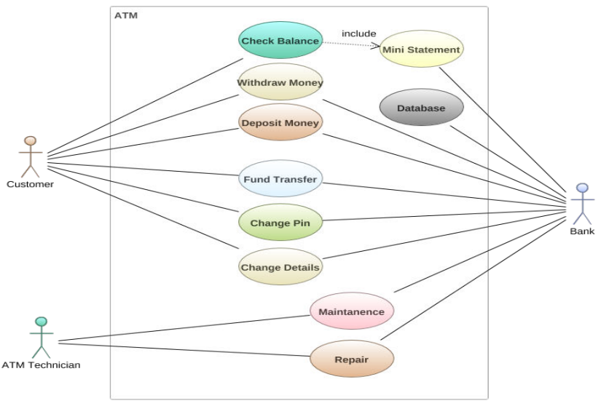

Slide 23
UML
The UML is a language for
visualizing
specifying
constructing
documenting
UML is a language which combines vocabulary and rules that tells us how to create and read well-framed models.

Slide 24
UML is a language for visualizing
Modeling of any system requires certain degree of visualization of the system.
If the developer directly codes the requirement of a system, he can have the following problems.
Communicating these conceptual models to others. As all speak different language, there are chances of error and understanding the system.
In a system development some things are best modeled textually, while some are best modeled graphically.
Thus UML is such a language that is more than just a bunch of graphical symbols. Each symbol in contrast has a well defined semantics which is best for visualization

Slide 25
UML is a language for specifying
Specifying means building models that are precise, unambiguous and complete.
In particular, UML addresses the specification of all the important analysis, design and implementation decisions that must be:
Scientific
Distributed web-based services.

Slide 26
UML is a language for constructing
The models of UML can directly be connected to a variety of programming languages i.e . It is possible to map a UML model to a programming language such as Java, C++, etc.

Slide 27
UML is a language for documenting
A healthy software organization produces all sorts of artifacts in addition to executable code.
Their artifacts include Requirements, Architecture, Design, Source code, Project plans, Tests, Prototypes, Release .
The UML addresses the documentation of a system’s architecture and all of its details.
The UML also provides the language for expressing requirements and for test.
Finally, the UML provides a language for modeling the activities of a project planning and release management

Slide 28
UML – Unified Modeling Language
The UML was adopted in 1997 as a standard by the OMG (Object Management Group, an industry standards body), and has continued to be refined in new OMG UML versions.
Unified because it …– Combines main preceding OO methods (Booch by Grady Booch, OMT by Jim Rumbaugh and OOSE by Ivar Jacobson)
Modeling because it is …– Primarily used for visually modeling systems. Many system views are supported by appropriate models
Language because …– It offers a syntax through which to express modeled knowledge

Slide 29
UML – Unified Modeling Language
UML is not:
A visual programming language or environment
A database specification tool
A development process (i.e. an SDLC)
A panacea (The ultimate solution)
A quality guarantee

Slide 30
UML – Unified Modeling Language
Helps to reduce cost and time-to-market.
Helps managing a complex project architecture.
Helps to convey ideas between developers\designers\etc.

Slide 31
UML Diagrams
UML can be used to construct nine different types of diagrams to capture five different views of a system.
The different UML diagrams provide different perspectives of the software system to be developed and facilitate a comprehensive understanding of the system.
Such models can be refined to get the actual implementation of the system.

Slide 32
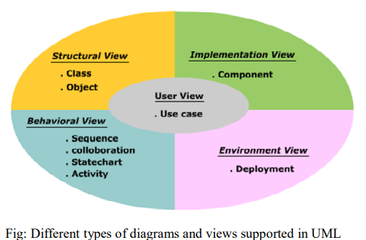
UML Diagrams
The UML diagrams can capture the following five views of a system:
User’s view
Structural view
Behavioral view
Implementation view
Environmental view

Slide 33
UML Diagrams
User’s view: This view defines the functionalities (facilities) made available by the system to its users. The users’ view captures the external users’ view of the system in terms of the functionalities offered by the system.
Structural view: The structural view defines the kinds of objects (classes) important to the understanding of the working of a system and to its implementation. It also captures the relationships among the classes (objects). The structural model is also called the static model since the structure of a system does not change with time.

Slide 34
UML Diagrams
Behavioral view: The behavioral view captures how objects interact with each other to realize the system behavior. The system behavior captures the time-dependent (dynamic) behavior of the system
Implementation view: This view captures the system’s important components and dependencies
Environmental view: This view models how the different components are implemented on various pieces of hardware

Slide 35
UML Diagrams
UML
Structural
Diagram
Behavioral
Diagram
Class
Diagram
Use Case
Diagram
Object
Diagram
Sequence
Diagram
Component
Diagram
Collaboration
Diagram
Deployment
Diagram
State Chart
Diagram
Activity
Diagram

Slide 36
UML Diagrams
Use case diagram: shows a set of use cases, and how actors can use them
Class diagram: describe the structure of the system, divided into classes with different connections and relationships
Sequence diagram: shows the interaction between a set of objects, through the messages that may be dispatched between them
State chart diagram: state machines, consisting of states, transitions, events, and activities
Activity diagram: shows the flow through a program from a defined start point to an endpoint
Object diagram: a set of objects and their relationships, this is a snapshot of instances of the things found in the class diagrams

Slide 37
UML Diagrams
Collaboration diagram: collaboration diagrams emphasize the structural ordering of objects that send and receive messages.
Component diagram: show organizations and dependencies among a set of components. These diagrams address the static implementation view of the system.
Deployment diagram: show the configuration of run-time processing nodes and components that live on them.

Slide 39
PREVIEW FOR LECTURE 6
REPRESENTATION OF SYSTEM BEHAVIOR
SYSTEM SEQUENCE DIAGRAM

